Slide 1

Project Talking Bench
Team Benchmark
Maarten Marx, Mark Vaikul, Filip Kolb, Egemen Alkan, Lorenzo Miechielsen

Slide 2
Summary
Our Team
How it Works
Risks
Hardware Components
Cost structure
AI Technology
From Bench to Data
Frontend/Backend Technologies
Designs

Slide 3
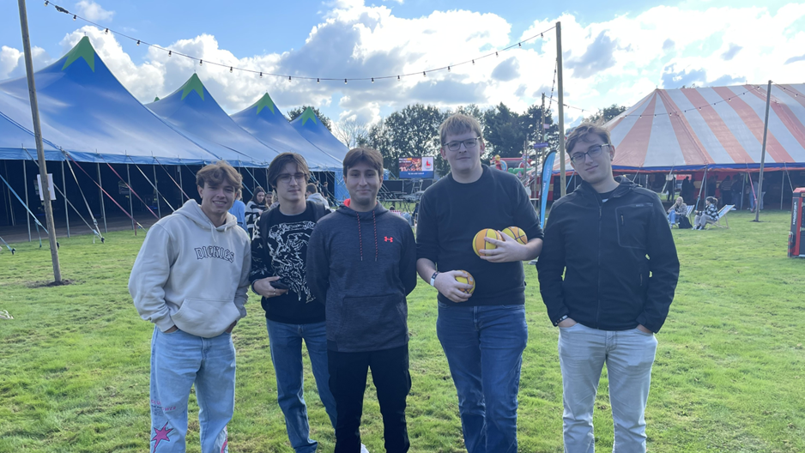
Our Team

Slide 4

How it works

Slide 5



Risks

Slide 6
Hardware

Slide 7
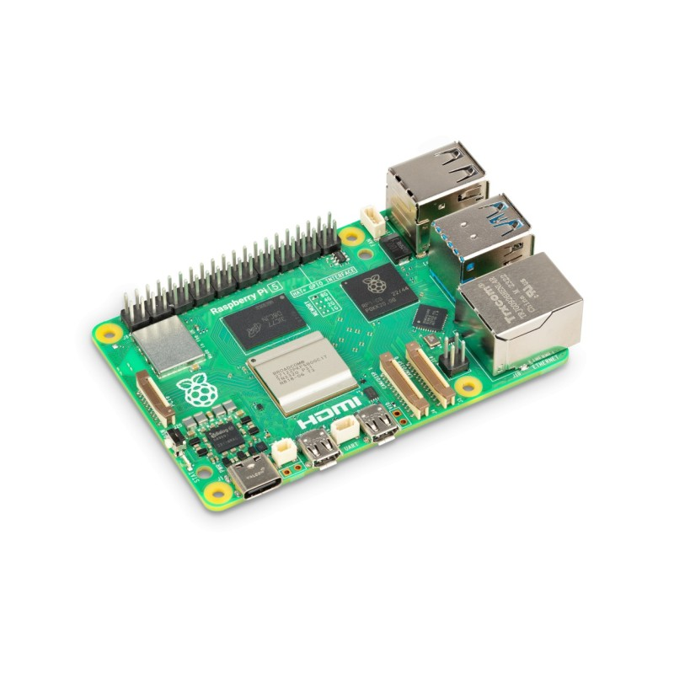
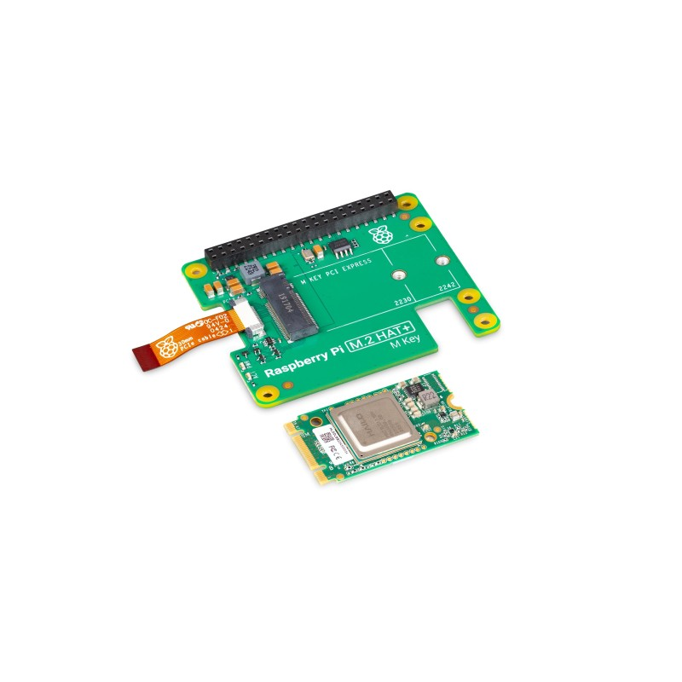
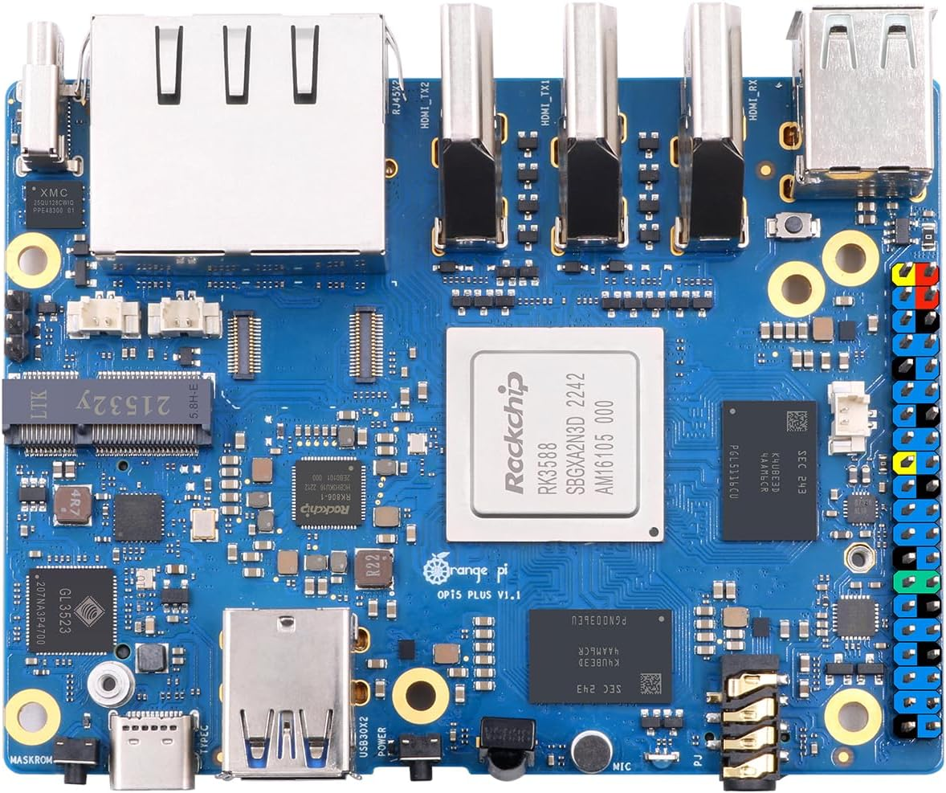
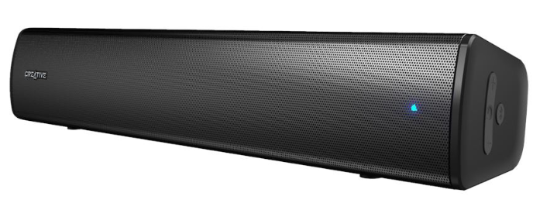
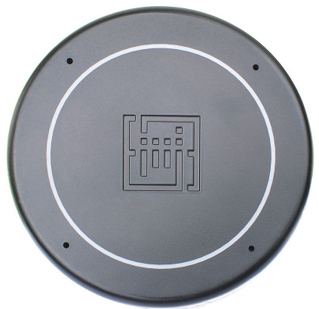
Hardware components

Slide 8
Cost structure
€ 79,95
€ 129,95
€ 49,99
€ 79,61

Slide 9
AI Technologies

Slide 10



AI Technologies
OpenAI
BERTje
GoEmotions

Slide 11


STT/TTS

Slide 12


Noise reduction

Slide 13
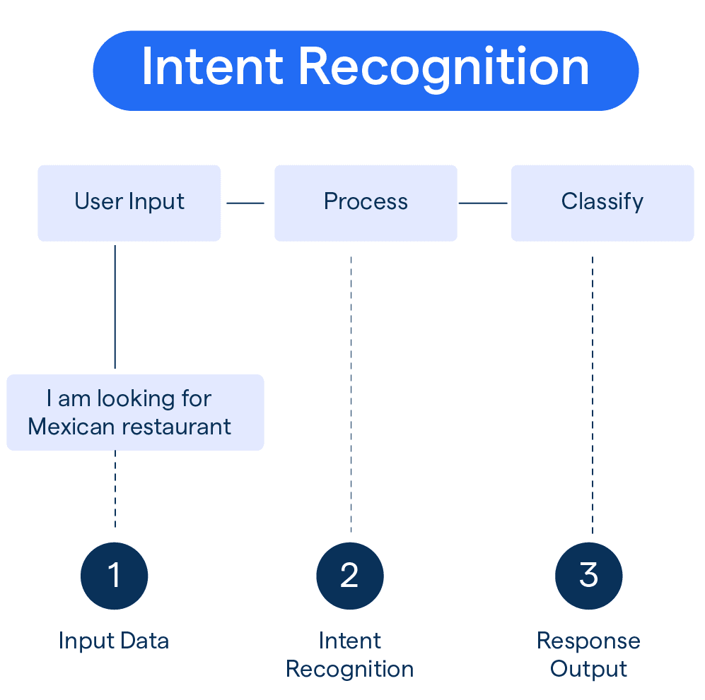
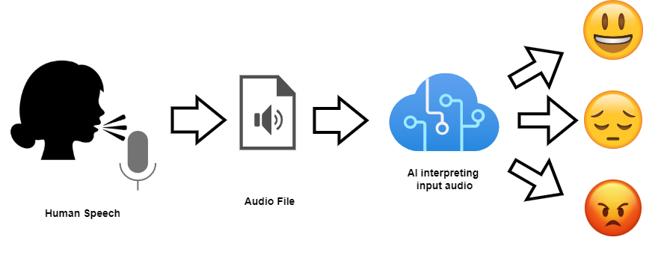
Intent classification/Emotion detection

Slide 14


Response generation/Cost

Slide 15
From Bench to Data

Slide 16




Cloud and Data management

Slide 17
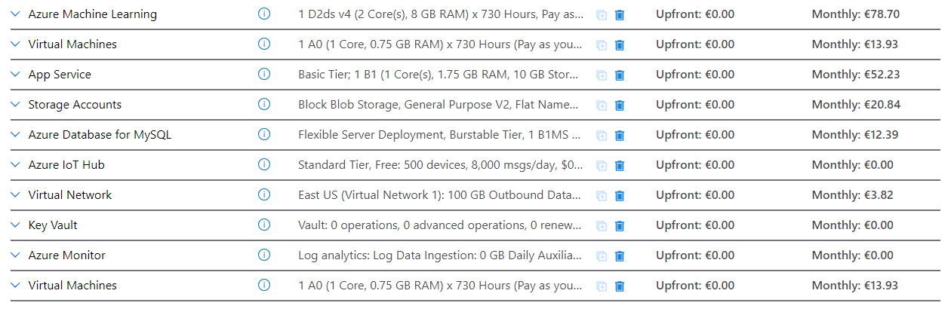
Cost Infrastructure

Slide 18
Frontend/Backend Technologies

Slide 19



Frontend/Backend Technologies

Slide 20
Designs

Slide 21
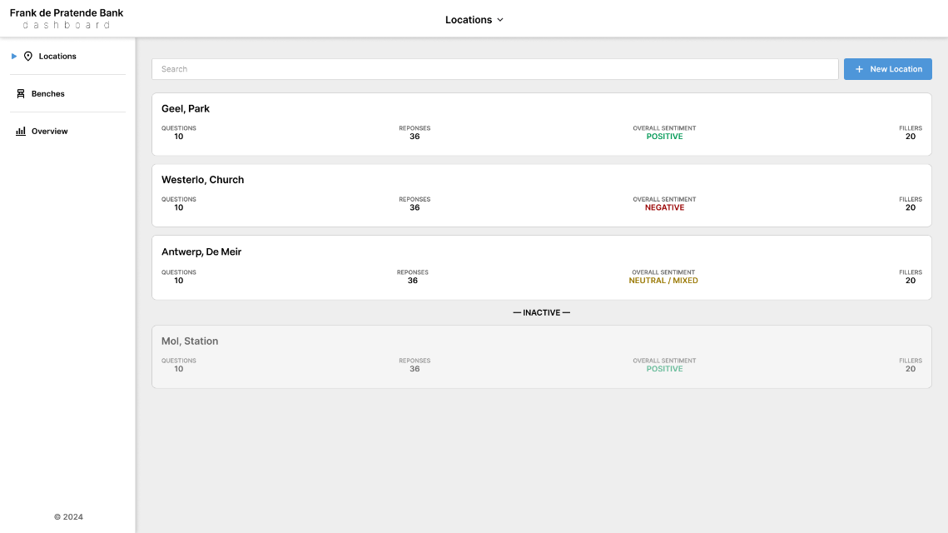
Locations

Slide 22
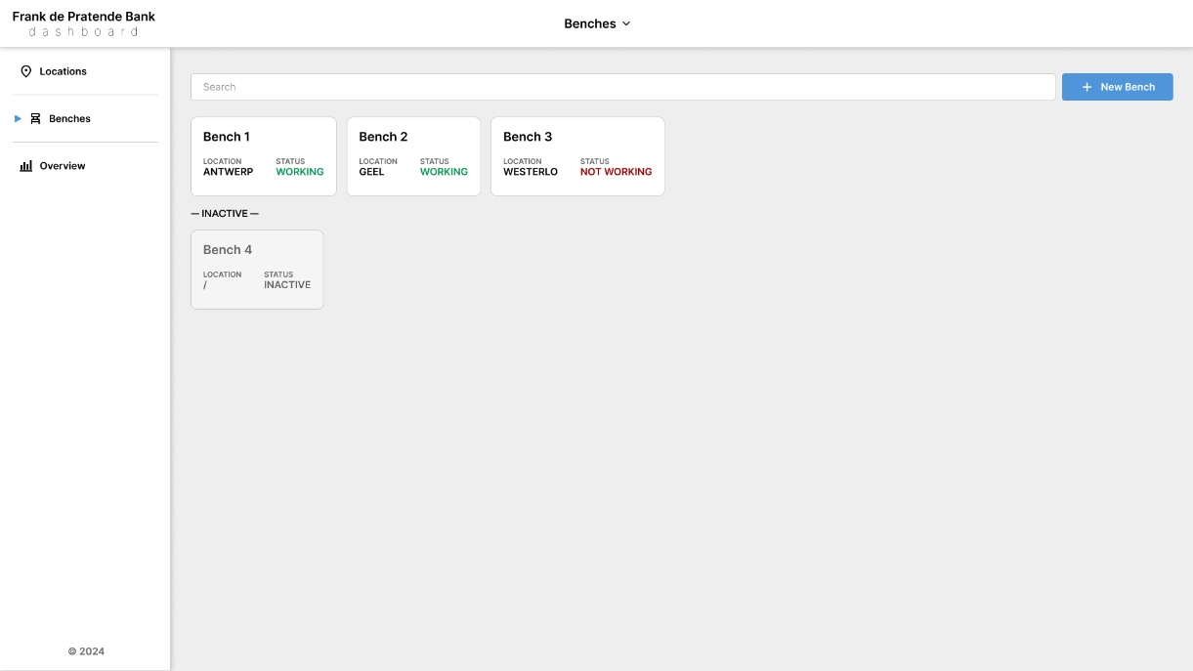
Benches

Slide 23
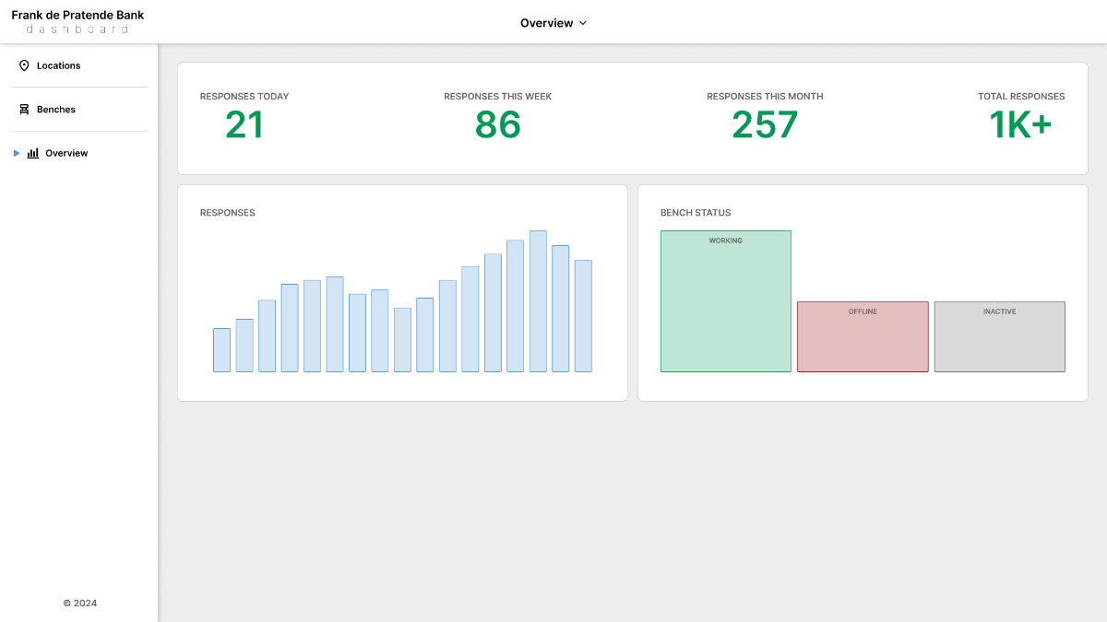
Statistics

Slide 24
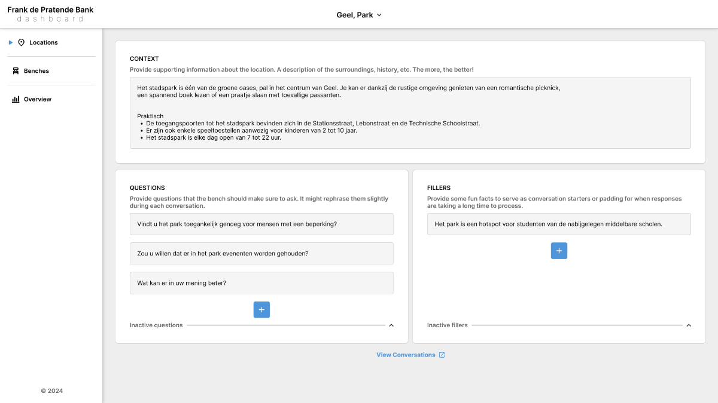
Location Management

Slide 25
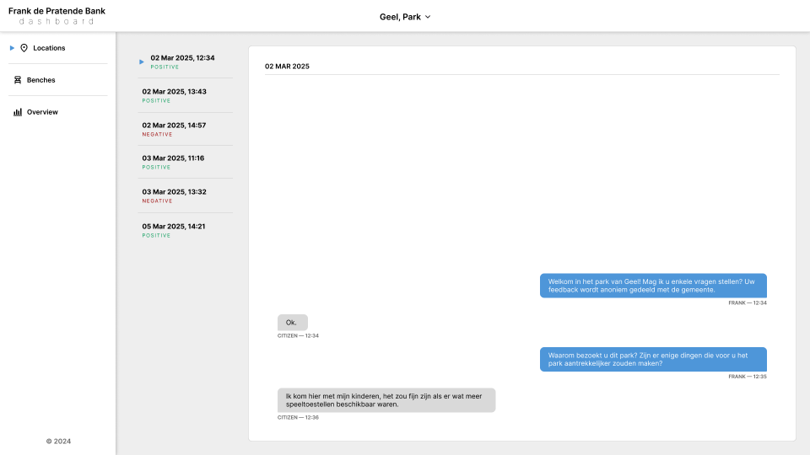
Conversation

Slide 26
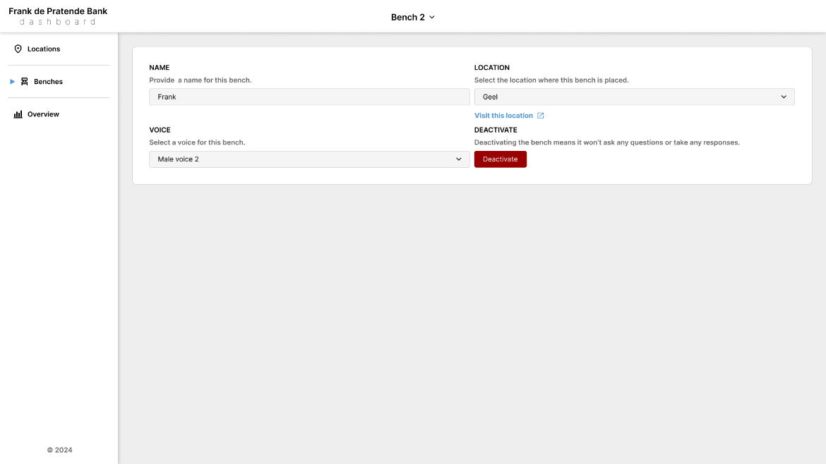
Bench Management

Slide 27

Questions?

